Slide 1
Classification Advanced
Decision Trees
Mikołaj Nawojowski, Wojciech Nowak

Slide 2
AGENDA
Decision Trees introduction with a draft of used example
Assigment: Identyfing safe loans with decision trees
Binary Decision Trees introduction
Assignment: Implementing binary decision trees

Slide 3
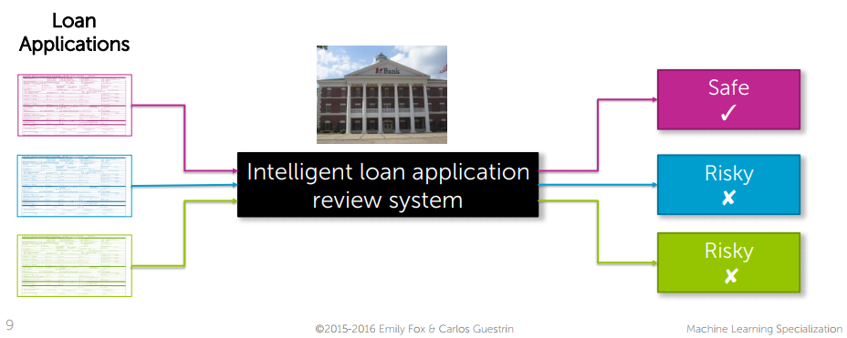
used example

Slide 4
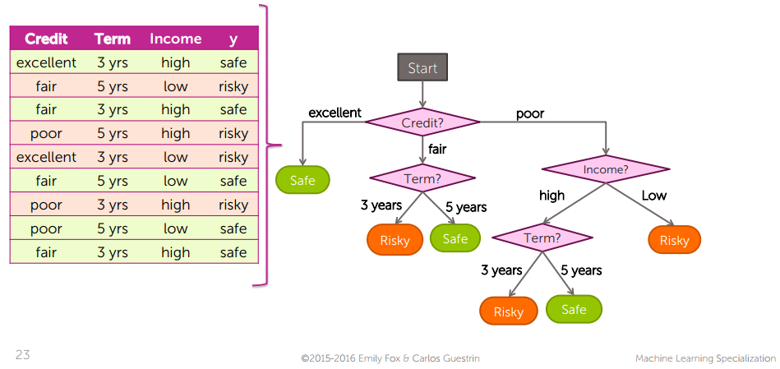
Decision tree

Slide 5
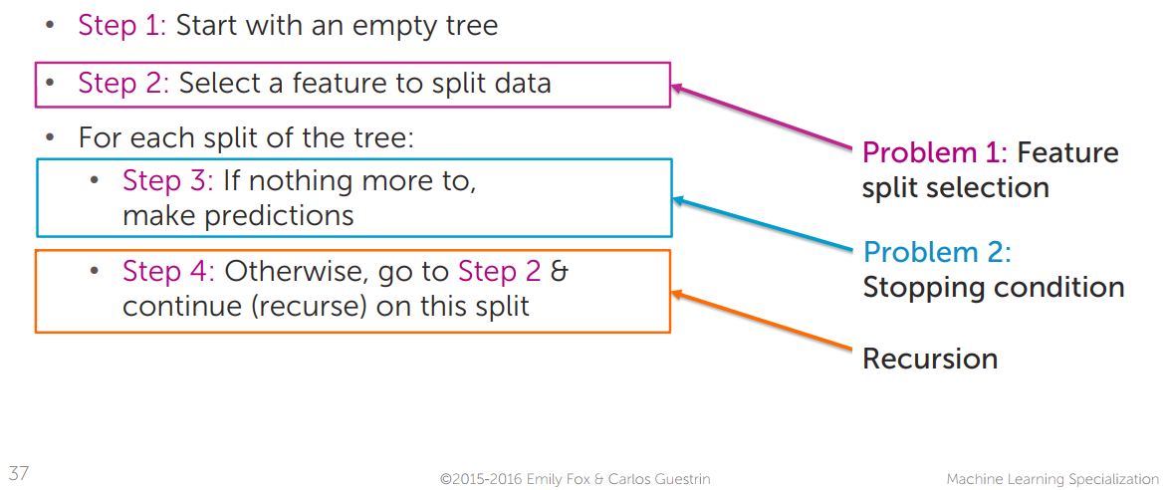
greedy decision tree learning

Slide 6
Sources
Coursera Course: Machine Learning: Classification: week 3 Decision Trees module by University of Washington (Emily Fox. Carlos Guestrin)

Slide 7
Thank you for your attention!

